Slide 1

CHAPTER 5: THREADS AND CONCURRENCY
OPERATING SYSTEMS (CS-2006) SPRING 2022, FAST NUCES
anaum.hamid@nu.edu.pk

Slide 2
Motivation
Most modern applications are multithreaded
Threads run within application
Multiple tasks with the application can be implemented by separate threads
Update display
Fetch data
Spell checking
Answer a network request
Process creation is heavy-weight while thread creation is light-weight
Can simplify code, increase efficiency
Kernels are generally multithreaded

Slide 3
Control Blocks
Information associated with each process: Process Control Block
Memory management information
Accounting information
Information associated with each thread: Thread Control Block
Program counter
CPU registers
CPU scheduling information
Pending I/O information
‹#›

Slide 4
Control Blocks
Process ID (PID)
Parent PID
…
Next Process Block
PCB
List of open ﬁles
Handle Table
Image File Name
Thread Control Block (TCB)
List of Thread Control Blocks
…
Next TCB
Program Counter
Registers
…
0

Slide 5
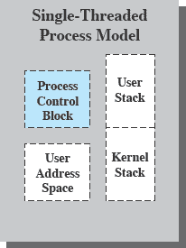
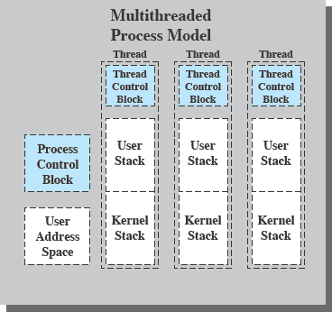
Single & Multithreading Process
Each thread has
An execution state (Running, Ready, etc.)
Saved thread context when not running
An execution stack
Some per-thread static storage for local variables
Access to the memory and resources of its process (all threads of a process share this)
Suspending a process involves suspending all threads of the process
Termination of a process terminates all threads within the process
6

Slide 6
Threads
Threads specific
Attributes….
Threads share….
Global memory
Process ID and parent process ID
Controlling terminal
Process credentials (user )
Open file information
Timers
………
Thread ID
Thread specific data
CPU affinity
Stack (local variables and function call linkage information)
……

Slide 7
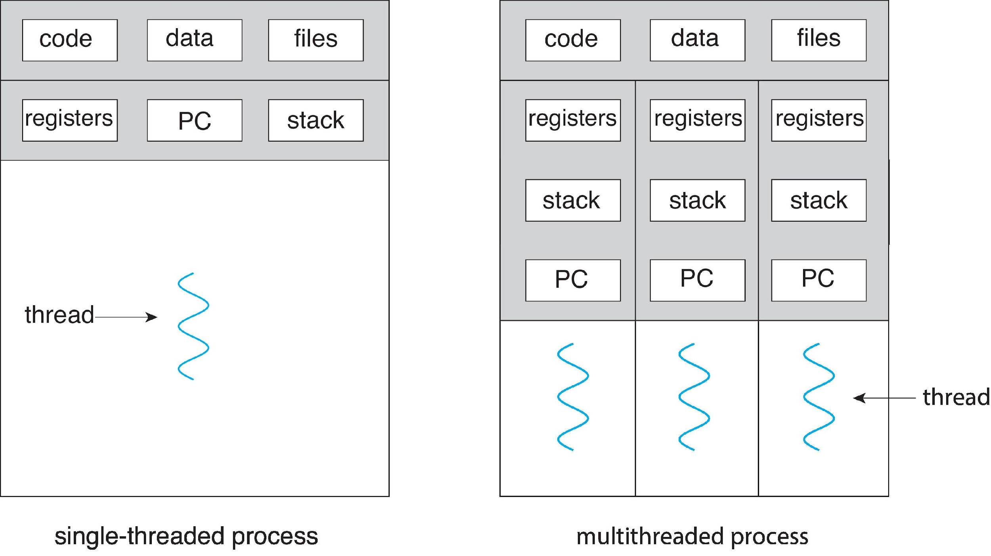
Single and Multithreaded Processes

Slide 8
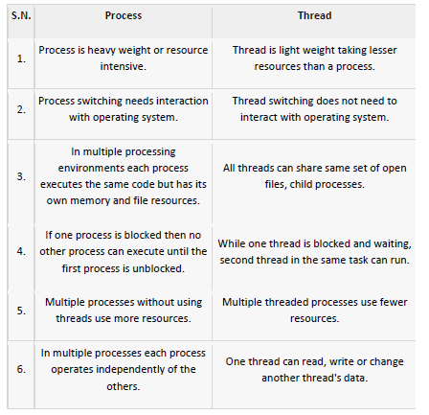
Process Vs. Threads

Slide 9
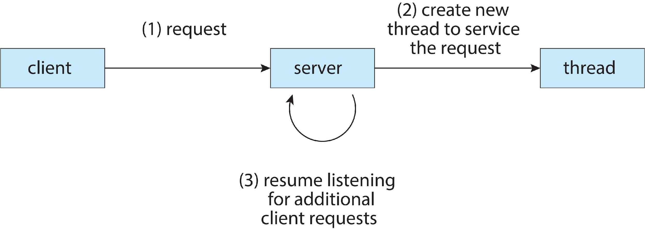
Multithreaded Server Architecture

Slide 10
Benefits
Responsiveness – One thread may provide rapid response while other threads are blocked or slowed down doing intensive calculations.
Resource Sharing – By default threads share common code, data, and other resources, which allows multiple tasks to be performed simultaneously in a single address space.
Economy – Creating and managing threads ( and context switches between them ) is much faster than performing the same tasks for processes.
Scalability – Utilization of multiprocessor architectures - A single threaded process can only run on one CPU, no matter how many may be available, whereas the execution of a multi-threaded application may be split amongst available processors.

Slide 11
Multicore Programming
A recent trend in computer architecture is to produce chips with multiple cores, or CPUs on a single chip.
Parallelism implies a system can perform more than one task simultaneously
Concurrency supports more than one task making progress
Single processor / core, scheduler providing concurrency

Slide 12
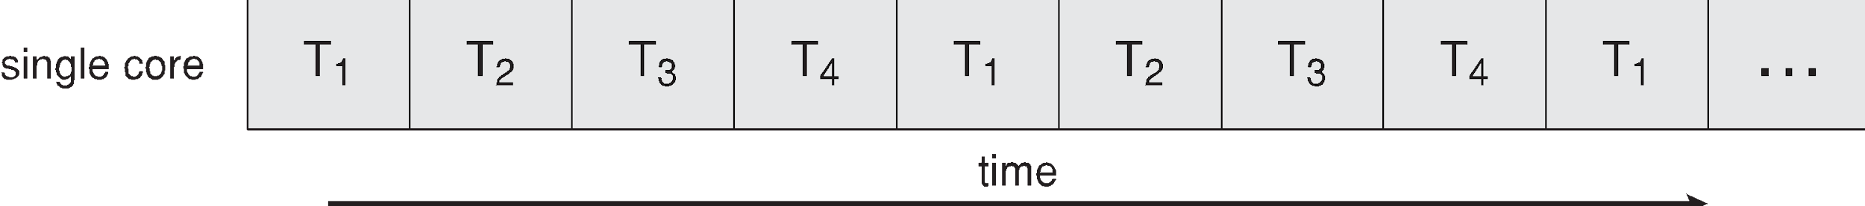
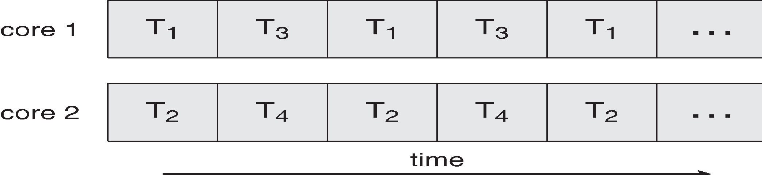
Concurrency vs. Parallelism
Concurrent execution on single-core system:
Parallelism on a multi-core system:

Slide 13
Thread Dispatching
Thread T₁
Interrupt or system call
Thread T₂
executing
Save state into TCB₁
ready or waiting
Reload state from TCB₂
Interrupt or system call
ready or waiting
executing
Save state into TCB₂
Reload state from TCB₁
ready or waiting
executing

Slide 14
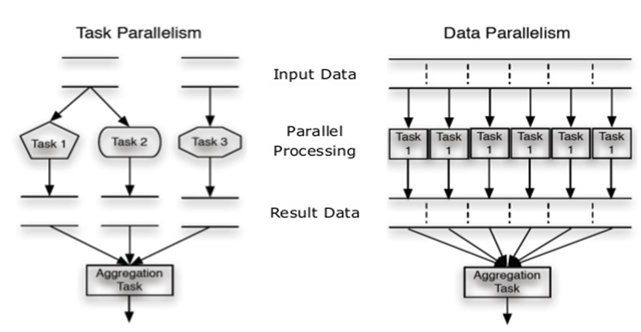
Types of Parallelism

Slide 15
Data vs. Task Parallelism
Data Parallelism | Task Parallelism
Same operations are performed on different subsets of same data. | Different operations are performed on the same or different data.
Synchronous computation | Asynchronous computation
Speedup is more as there is only one execution thread operating on all sets of data. | Speedup is less as each processor will execute a different thread or process on the same or different set of data.
Amount of parallelization is proportional to the input data size. | Amount of parallelization is proportional to the number of independent tasks to be performed
Designed for optimum load balance on multi processor system. | Load balancing depends on the availability of the hardware and scheduling algorithms like static and dynamic scheduling.
Course Supervisor: ANAUM HAMID

Slide 16

Amdahl’s Law
gives the theoretical speedup in latency of the execution of a task at fixed workload that can be expected of a system whose resources are improved
Where S = portion of program executed serially
N = Processing Cores

Slide 17
Amdahl’s Law Example
we have an application that is 75 percent parallel and 25 percent serial. If we run this application on a system with two processing
cores?
S=25%=0.25, N= 2
If we add two additional cores , calculate speedup?

Slide 18
Types of Threads
Support provided at either
User level -> user threads
Supported above the kernel and managed without kernel support
Kernel level -> kernel threads
Supported and managed directly by the operating system
What is the relationship between user and kernel threads?

Slide 19
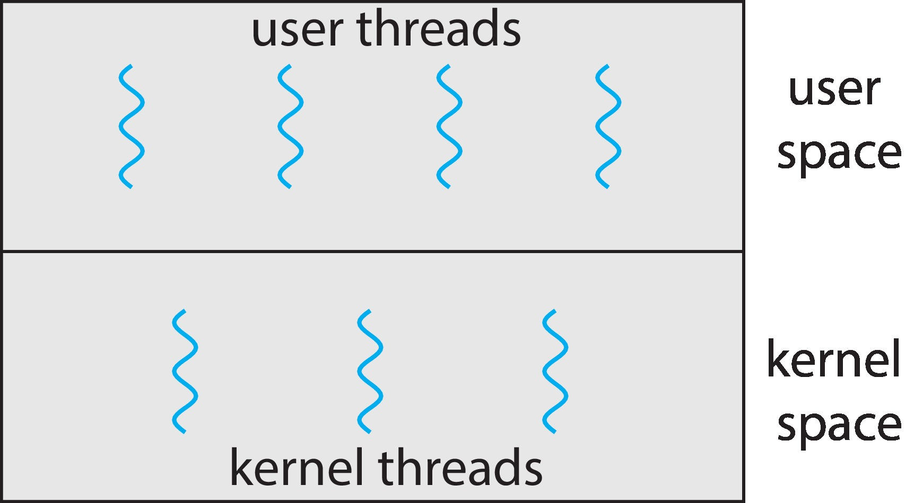
User and Kernel Threads

Slide 20
User Threads
Thread management done by user-level threads library
Three primary thread libraries:
POSIX Pthreads
Win32 threads
Java threads

Slide 21
Kernel Threads
Supported by the Kernel
Examples
Windows
Linux
Mac OS X
iOS
Android

Slide 22
Multithreading models
In a specific implementation, the user threads must be mapped to kernel threads, using these listed below Multithreading Models:
Many-to-One
One-to-One
Many-to-Many
User Thread – to - Kernel Thread

Slide 23
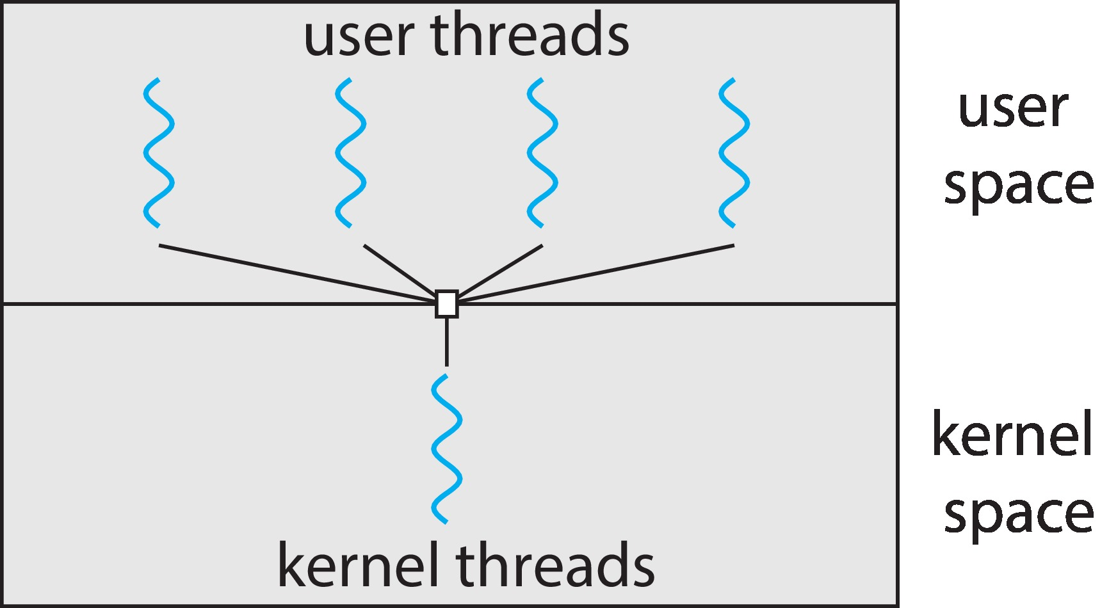
Many-to-One
Many user-level threads mapped to single kernel thread
Only one thread can access the kernel at a time,
multiple threads are unable to run in parallel on multicore systems.
the entire process will block if a thread makes a blocking system call

Slide 24
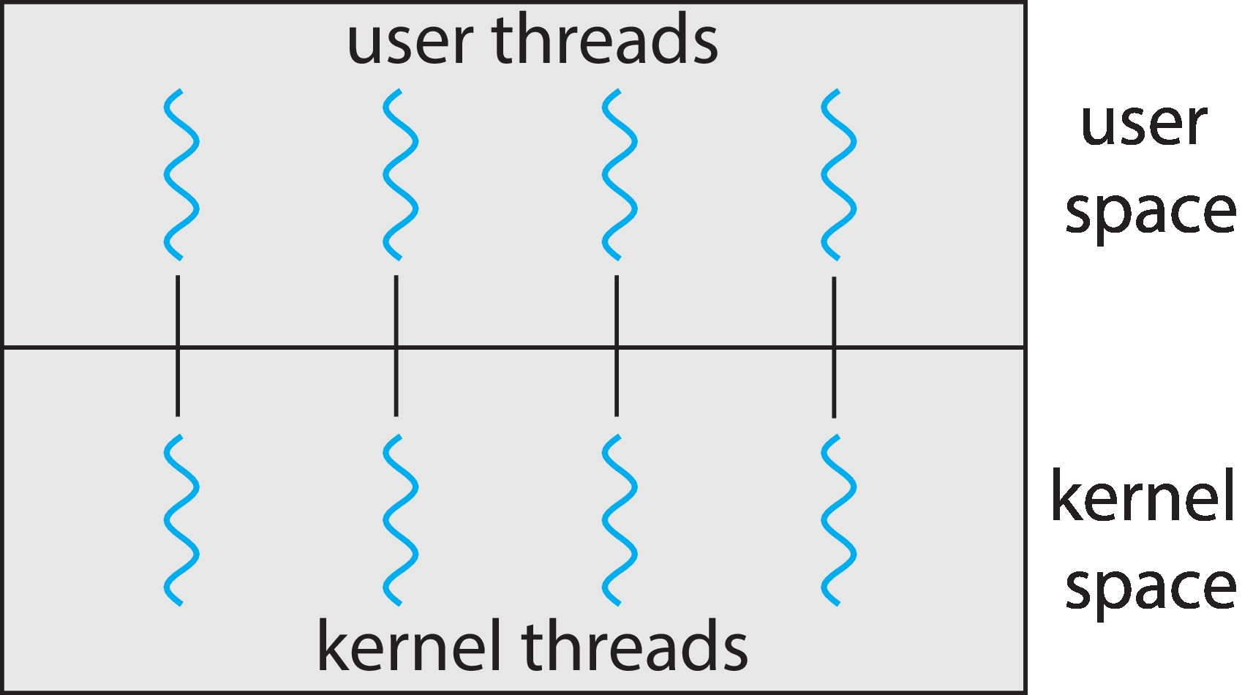
One-to-One
Each user-level thread maps to kernel thread
more concurrency than the many-to-one model by allowing another thread to run when a thread makes a blocking system call.
Allows multiple threads to run in parallel on multiprocessors.
drawback is, creating a user thread requires creating the corresponding kernel thread

Slide 25
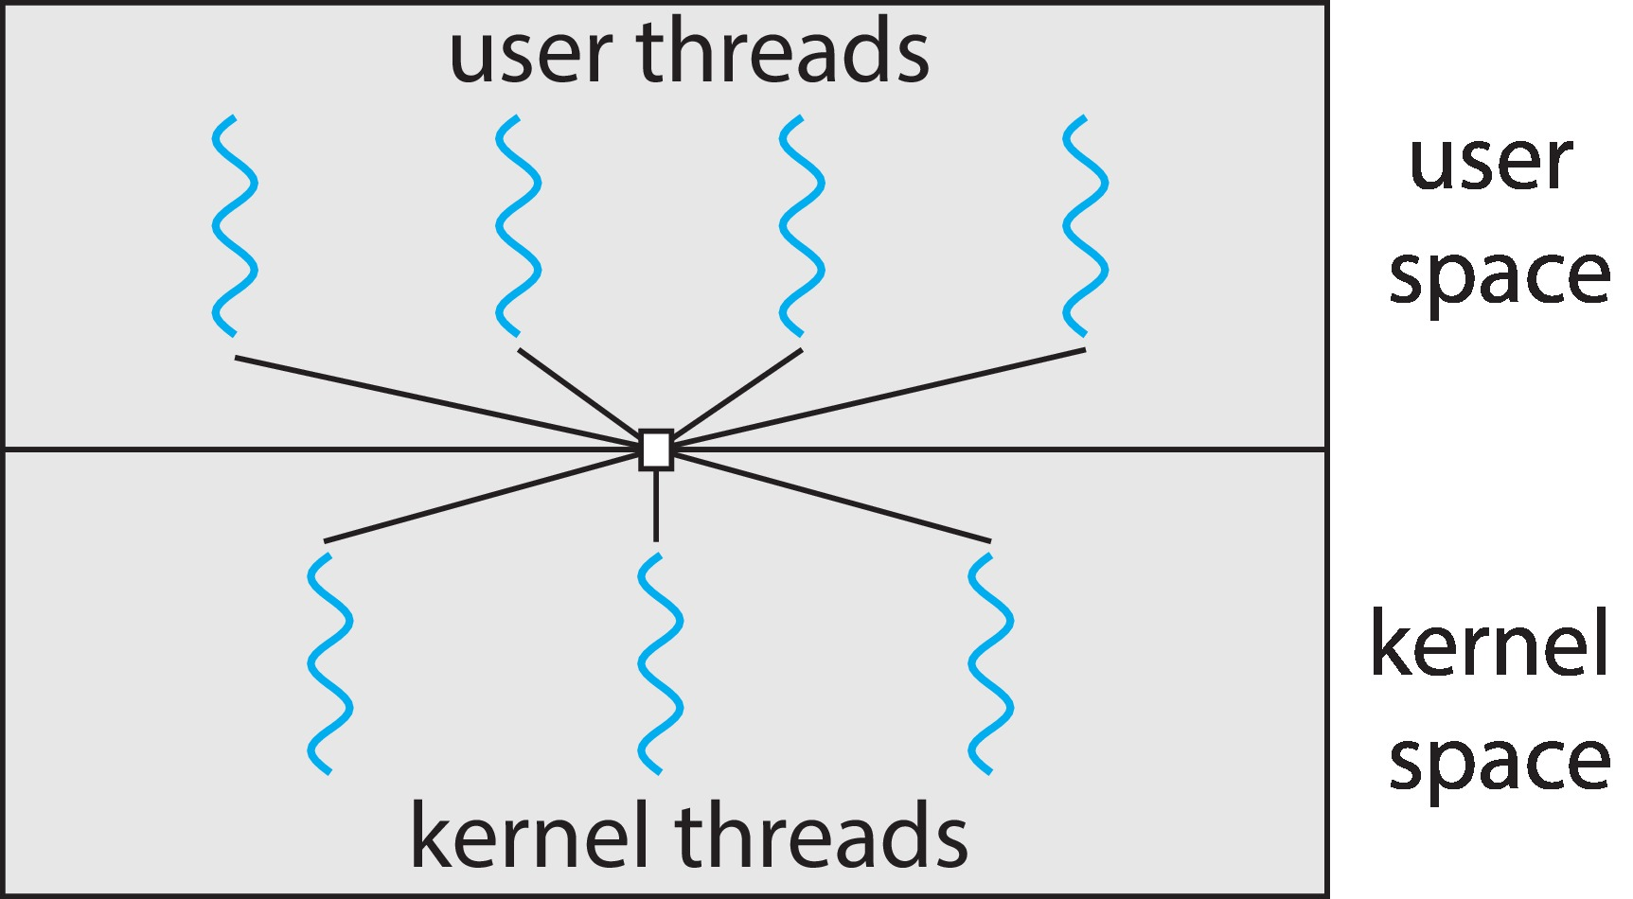
Many-to-Many Model
multiplexes many user-level threads to a smaller or equal number of kernel threads
developers can create as many user threads as necessary, and the corresponding
kernel threads can run in parallel on a multiprocessor.
When thread performs a blocking system call, the kernel can schedule another thread for
execution.

Slide 26
Thread Libraries
Three main thread libraries in use today:
POSIX Pthreads
May be provided either as user-level or kernel-level
A POSIX standard (IEEE 1003.1c) API for thread creation and synchronization
API specifies behavior of the thread library, implementation is up to development of the library
Win32
Kernel-level library on Windows system
Java
Java threads are managed by the JVM
Typically implemented using the threads model provided by underlying OS

Slide 27
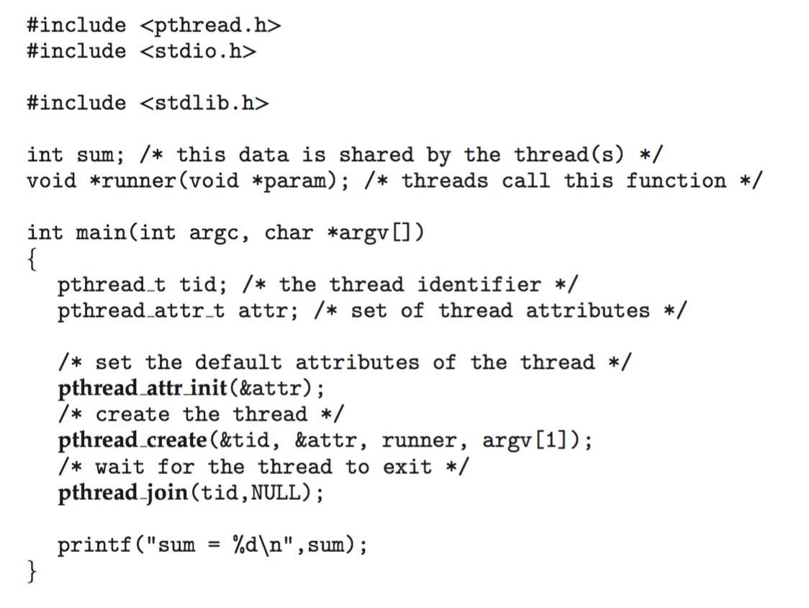
Pthreads Example

Slide 28
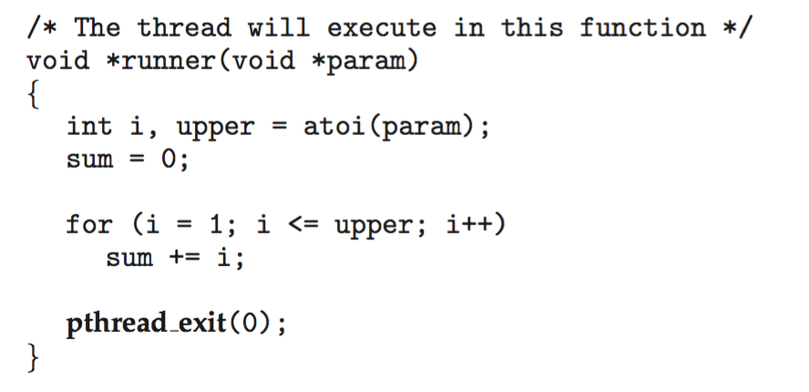
Pthreads Example (Cont.)

Slide 29
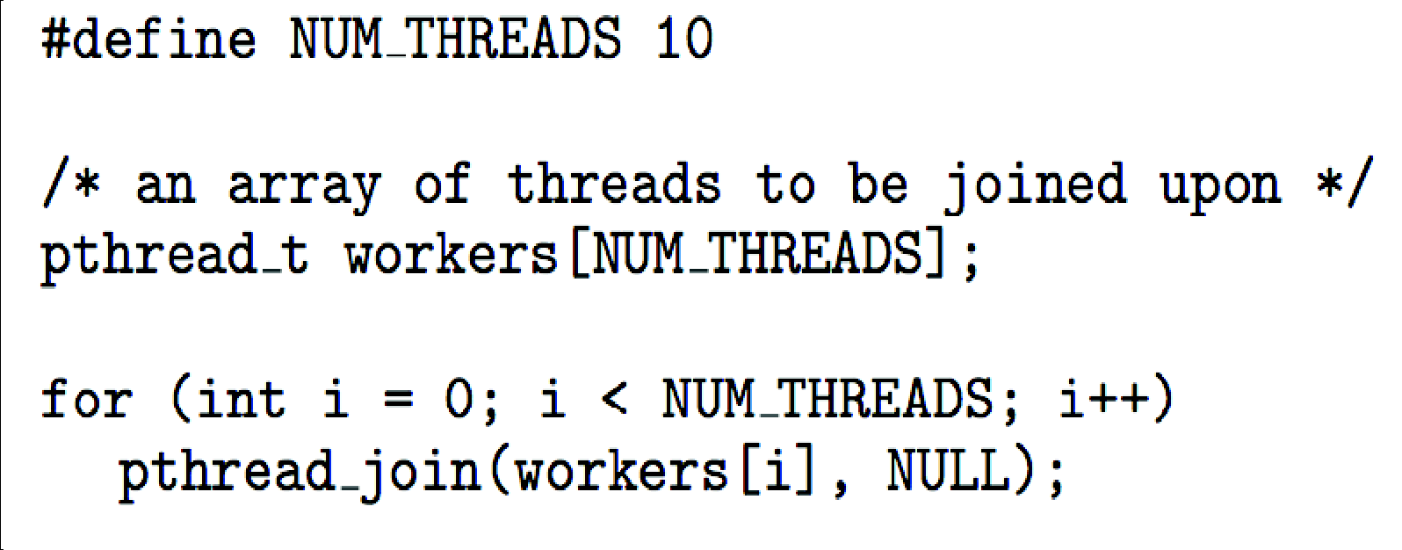
Pthreads Code for Joining 10 Threads

Slide 30
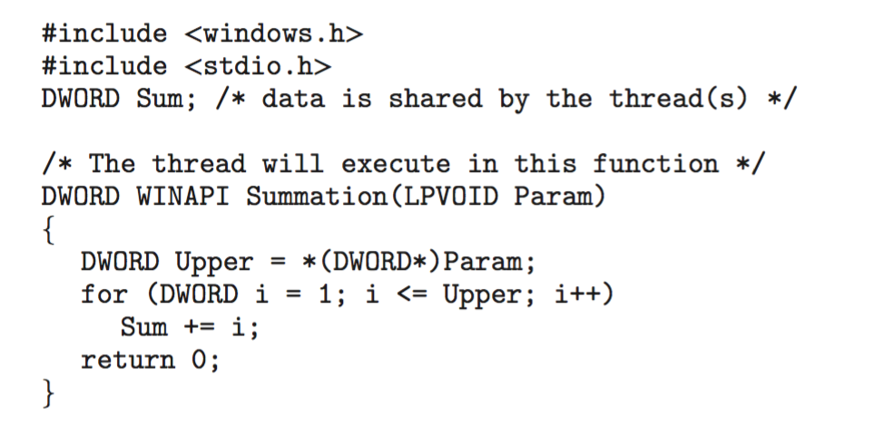
Windows Multithreaded C Program

Slide 31
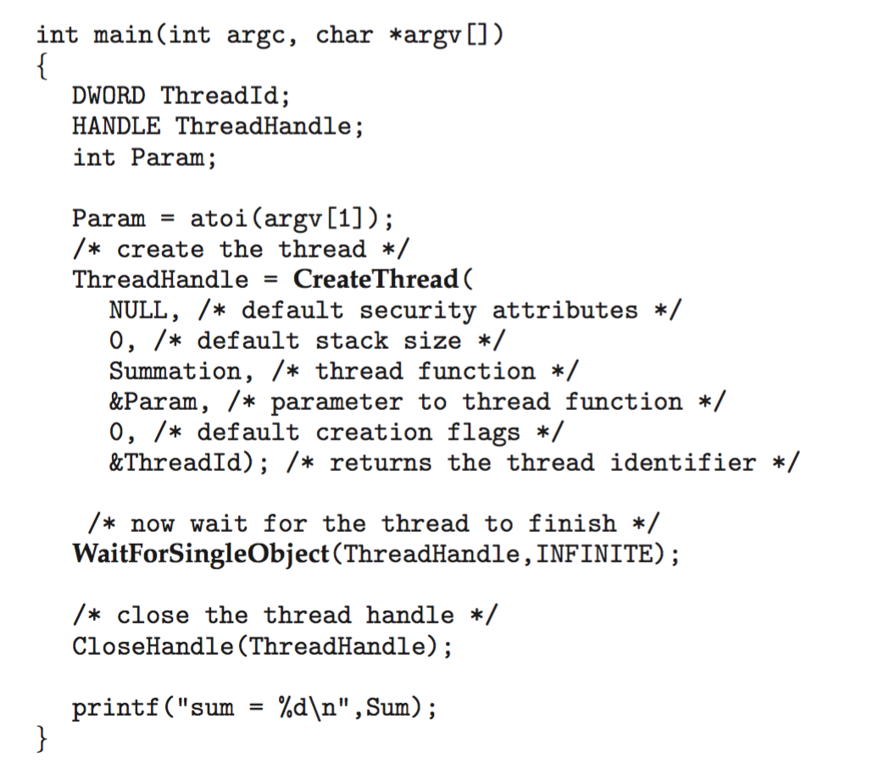
Windows Multithreaded C Program (Cont.)

Slide 32
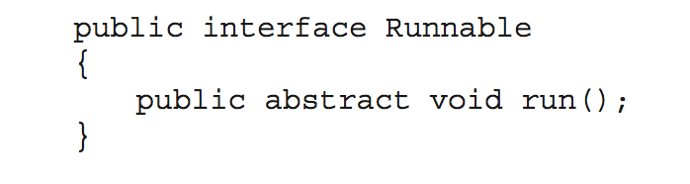
Java Threads
Java threads are managed by the JVM
Typically implemented using the threads model provided by underlying OS
Java threads may be created by:
Extending Thread class
Implementing the Runnable interface
Standard practice is to implement Runnable interface

Slide 33
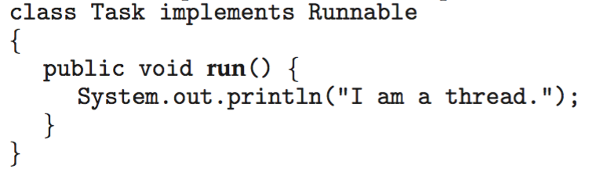
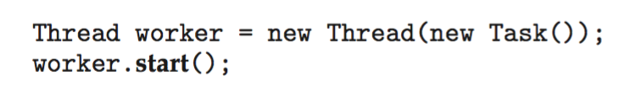
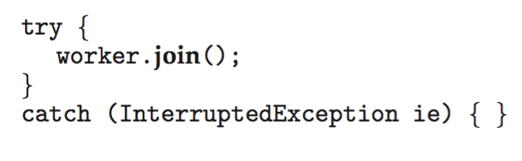
Java Threads
Implementing Runnable interface:
Creating a thread:
Waiting on a thread:

Slide 34
Implicit Threading
Creation and management of threads done by compilers and run-time libraries rather than programmers
These listed below methods explored
Thread Pools
Fork Join
OpenMP
Grand Central Dispatch.
Intel Threading Building Blocks

Slide 35
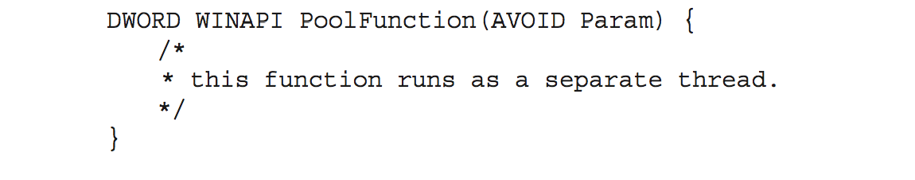
Thread Pools
Create a number of threads in a pool where they await work
Advantages:
Usually slightly faster to service a request with an existing thread than create a new thread
Allows the number of threads in the application(s) to be bound to the size of the pool

Slide 36
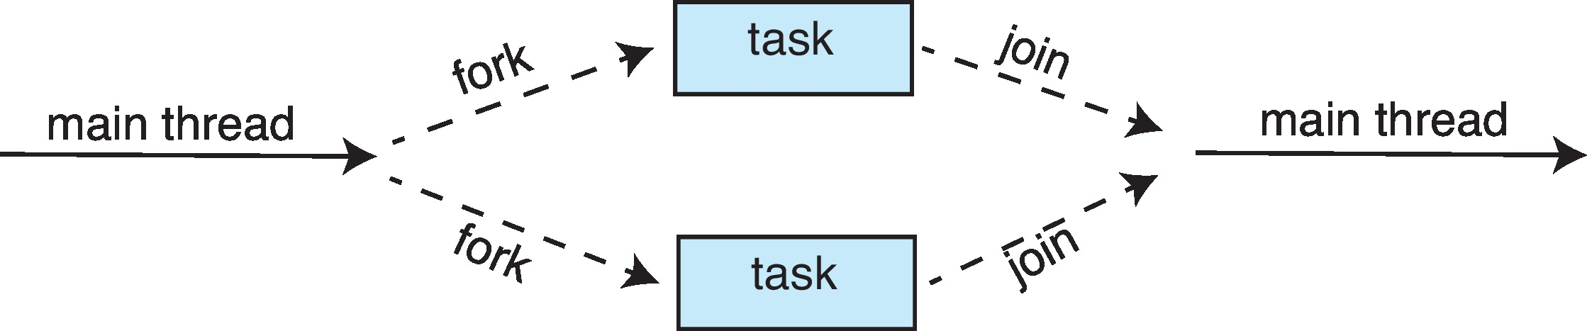
Fork-Join Parallelism
Multiple threads (tasks) are forked, and then joined.

Slide 37
OpenMP
An Application Program Interface (API) that may be used to explicitly direct multithreaded, shared memory parallelism
Three main API components
Compiler directives
Runtime library routines
Environment variables
Portable & Standardized
API exist both C/C++ and Fortan 90/77
Multi platform Support (Unix, Linux etc.)
Notes:
‹#›

Slide 38
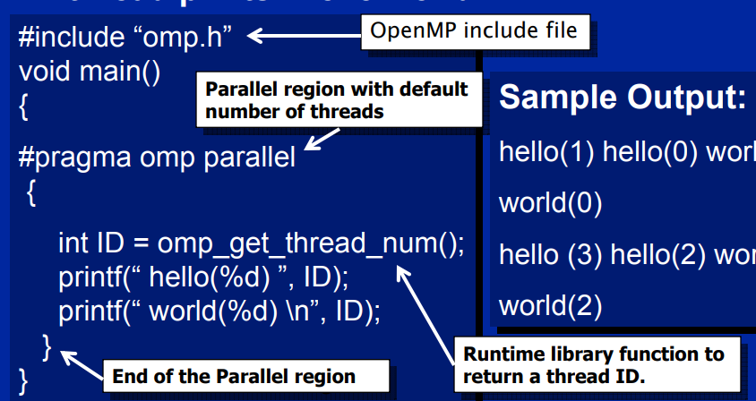
Open MP Example

Slide 39
Threading Issues
Semantics of fork() and exec() system calls
Signal handling
Thread cancellation of target thread
Thread-local storage
Scheduler Activations

Slide 40
Semantics of fork() and exec()
Does fork()duplicate only the calling thread or all threads?
Some UNIXes have two versions of fork
exec() usually works as normal – replace the running process including all threads

Slide 41
Thread Cancellation
Terminating a thread before it has finished
Thread to be canceled is target thread
Two general approaches:
Asynchronous cancellation terminates the target thread immediately
Deferred cancellation allows the target thread to periodically check if it should be cancelled
Cancellation only occurs when thread reaches cancellation point
i.e., pthread_testcancel()
Then cleanup handler is invoked

Slide 42
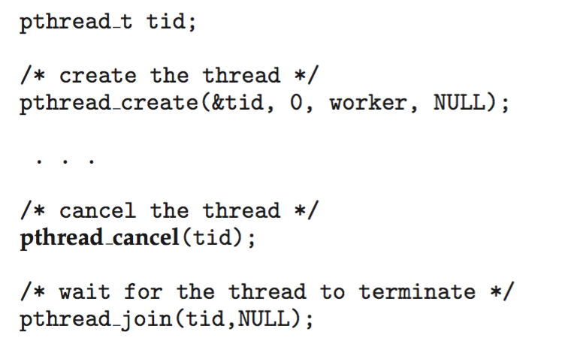
Pthread code to create and cancel a thread

Slide 43
Thread-Local Storage
Thread-local storage (TLS) allows each thread to have its own copy of data.
major thread libraries ( pThreads, Win32, Java ) provide support for thread-specific data, known as thread-local storage or TLS.
Course Supervisor: ANAUM HAMID

Slide 44
Signal Handling
Signals are used in UNIX systems to notify a process that a particular event has occurred.
A signal handler is used to process signals
Signal is generated by particular event
Signal is delivered to a process
Signal is handled by one of two signal handlers:
default
user-defined
Where should a signal be delivered for multi-threaded?
Deliver the signal to the thread to which the signal applies
Deliver the signal to every thread in the process
Deliver the signal to certain threads in the process
Assign a specific thread to receive all signals for the process

Slide 45
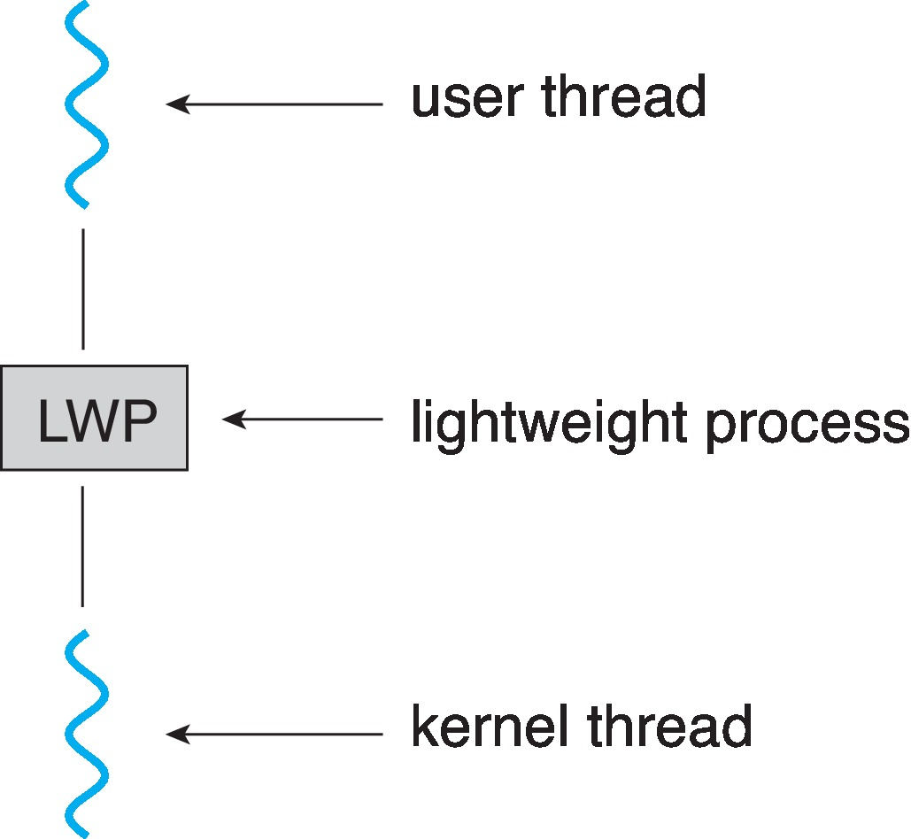
Scheduler Activations
Both M:M and Two-level models require communication to maintain the appropriate number of kernel threads allocated to the application
Typically use an intermediate data structure between user and kernel threads – lightweight process (LWP)
Appears to be a virtual processor on which process can schedule user thread to run
Each LWP attached to kernel thread
How many LWPs to create?
Scheduler activations provide upcalls - a communication mechanism from the kernel to the upcall handler in the thread library
This communication allows an application to maintain the correct number kernel threads

Slide 46
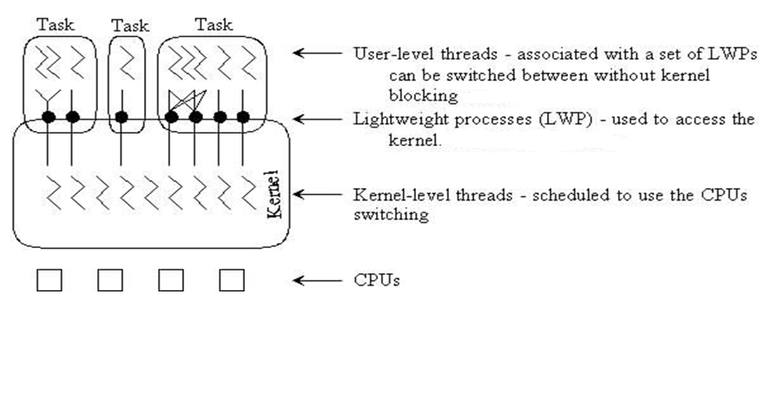
Kernel Scheduling

Slide 47
THANK YOU

